Slide 1
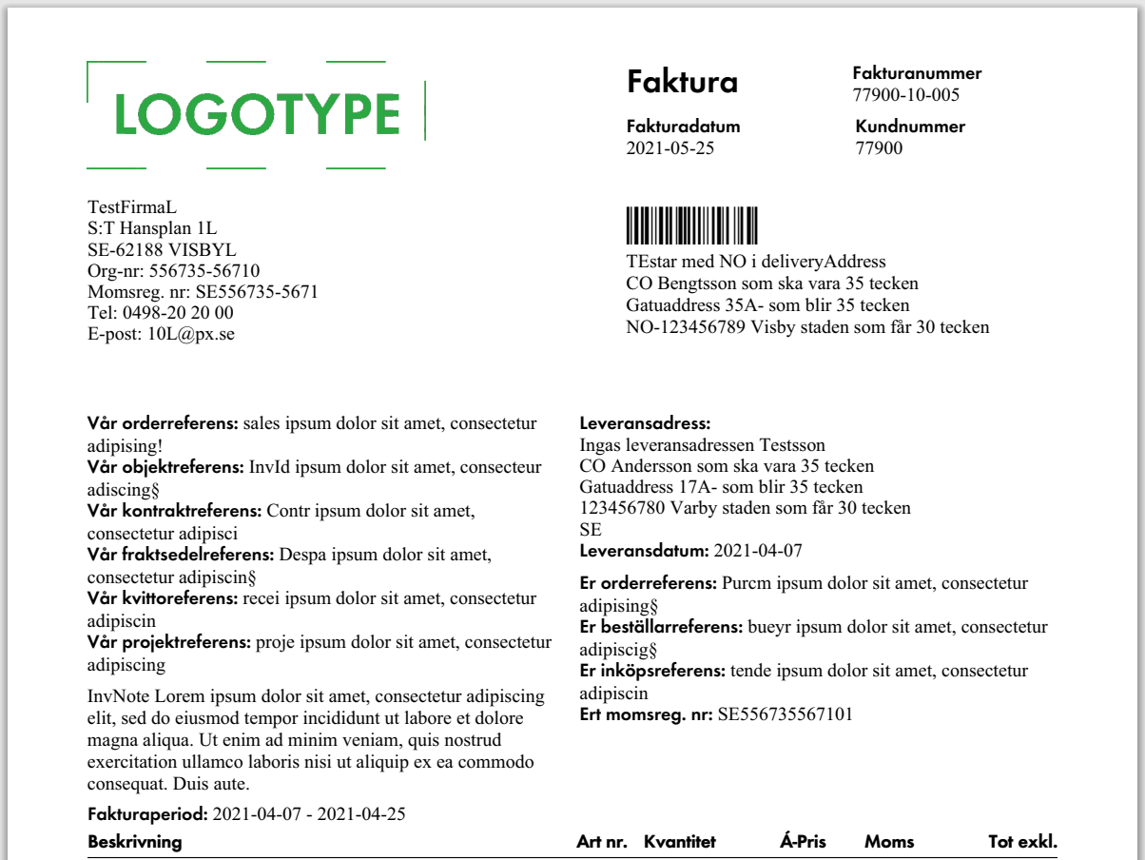
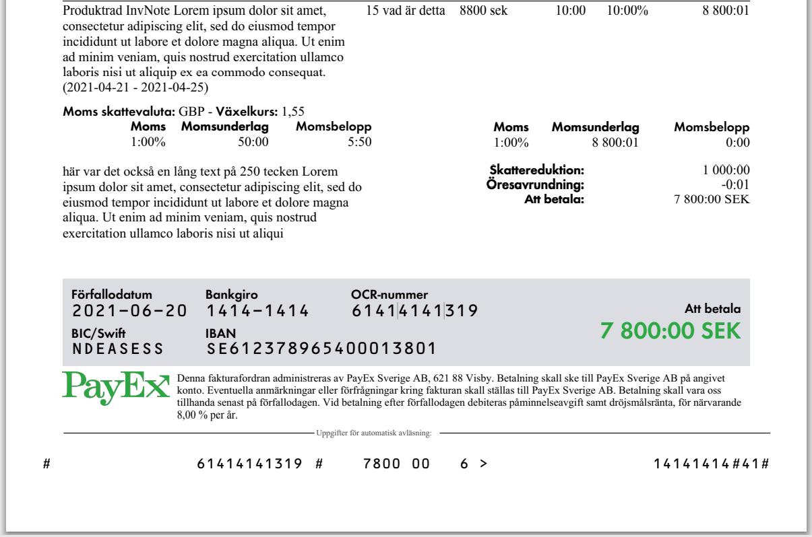
Mandatory
Mandatory, invoiceSpecification
Optional, invoiceSpecification
*Mandatory if distribution is set to EInvoiceB2B:
<quantity>
<unit>
<unitPrice>
Mandatory, invoiceVatSpecifications
Optional, referenceInfo
Optional, customerInfo
Optional, taxCurrencyVatSpecification
Optional, taxReduction
Header set by PayEx. If negative invoice amount is used, header will be set to ”Kreditfaktura”
<invoiceNo>
<customerNo>
<invoiceDate>
Barcode set by PayEx, used in postal distribution
Customer name and legal address are mandatory. <invoiceAddress> is optional and only used if different from customer name and legal address
Predefined logo sent to PayEx
<deliveryAddress>
Predefined company info
<deliveryDate>
<salesOrderReference>
<purchaseOrderReference>
<invoicedObjectIdentifier>
<buyerReference>
<contractReference>
<tenderReference>
<despatchReference>
<vatNo>
<receiptReference>
<debitInvoiceReferences>
<vatRate>
<projectReference>
<gtin>
<quantity>* + <unit>*
<uniPrice*>
<invoiceNote>
<amount>
If <inclVat> is True, amount must include Vat. If False, amount must exclude Vat.
EDI-distribution requires excl vat InvoiceSpecification
<invoicePeriod>
<itemDescription>
<datePeriod>
<taxableAmount>
<taxCurrencyCode>
<vatRate>
<exchangeRate>
<vatAmount>
<vatRate>
<taxReductionAmount>
<taxableAmount>
<roundingAmount>
<PayableAmount>
<vatAmount>
Header set by PayEx. If negative invoice amount is used, header will be set to ”Att erhålla”
<taxReductionDescription>
<preferredDueDate> if used or predefined minimum payment terms
Predefined currency supported in ledger
BIC/IBAN is set by PayEx and mandatory if invoiceAddress.countryCode differ from ledger default
<PayableAmount>
Predefined admin text set by PayEx
Predefined ledger info
Payment slip used for scanning set by PayEx
Unique payment reference calculated by PayEx

